Slide 1

Product Failure Kaggle Competition Fall 2023
Deliverable 1
Oct 14, 2023

Slide 2
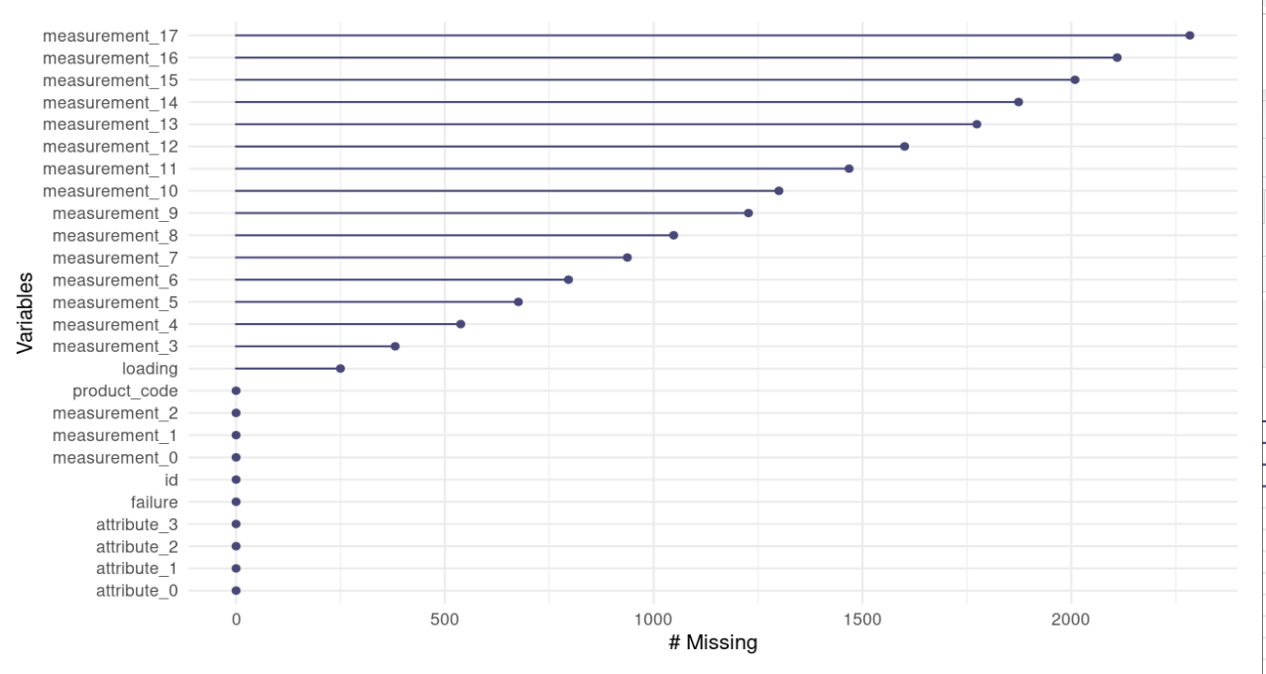
Data with missing values

Slide 3
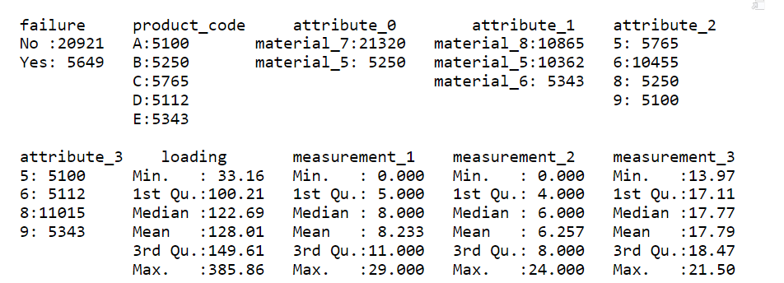
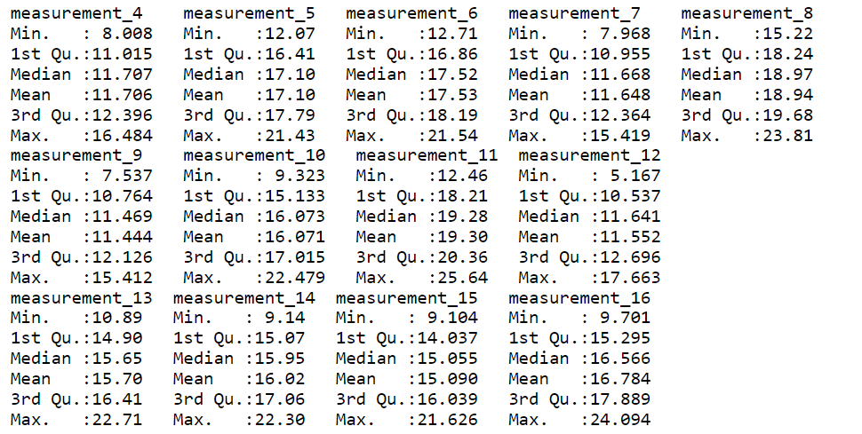
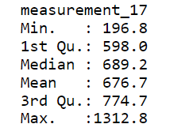
IMPUTED VALUES- data summary

Slide 4
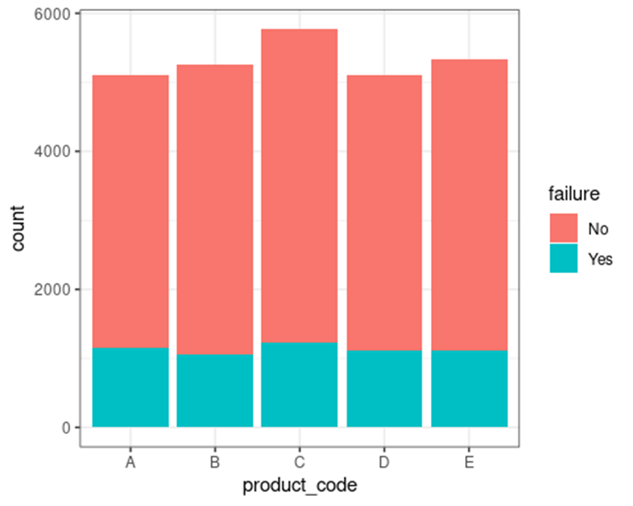
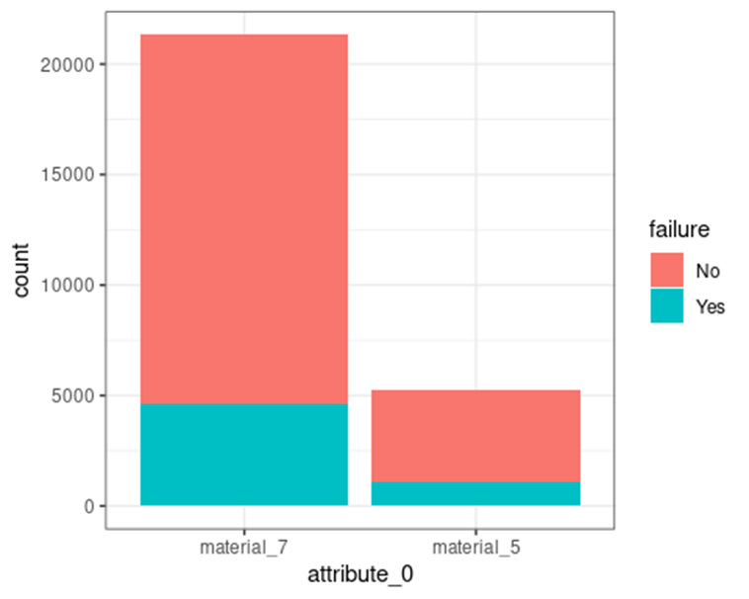
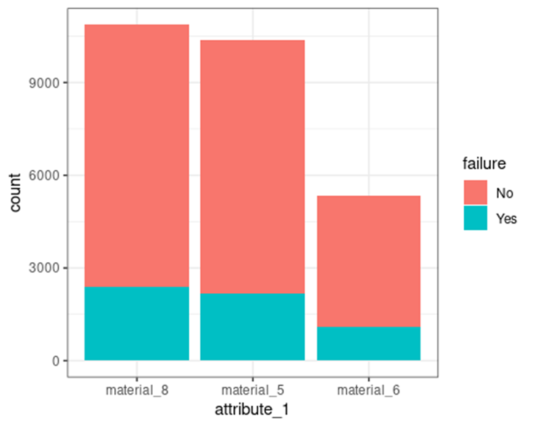
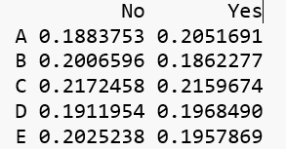
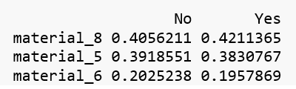

Failure proportions
Product code C has a higher percentage of "Yes" (failure) compared to the other product codes
Material 7 has a much higher percentage of "Yes" (failure) compared to material 5
Material 8 has a higher percentage of "Yes" (failure) compared to materials 5 & 6

Slide 5
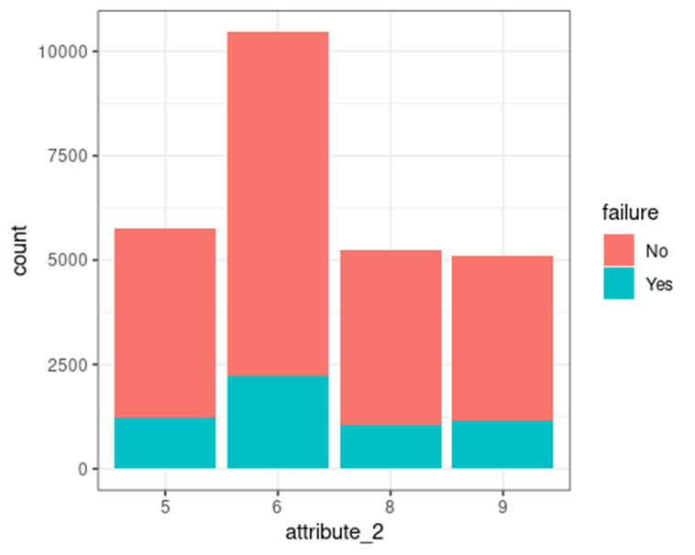
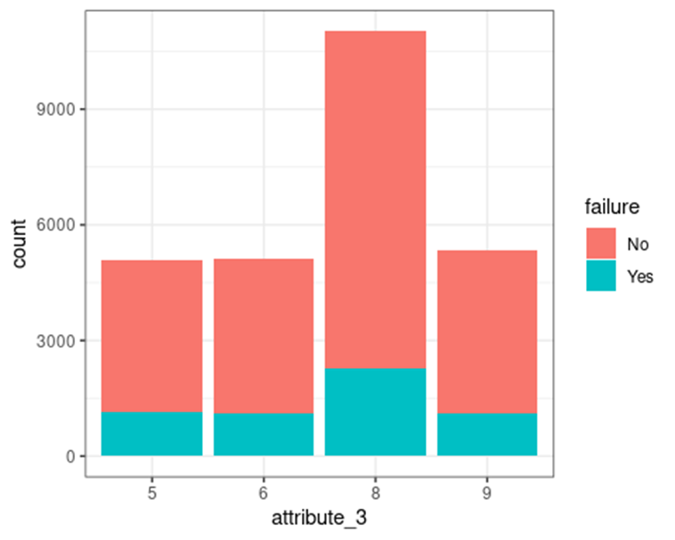
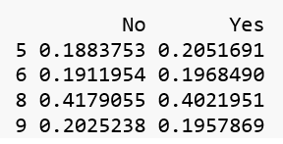
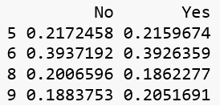
Failure proportions
Material 6 has a higher percentage of "Yes" (failure) compared to others
Material 8 has a higher percentage of "Yes" (failure) compared to others

Slide 6
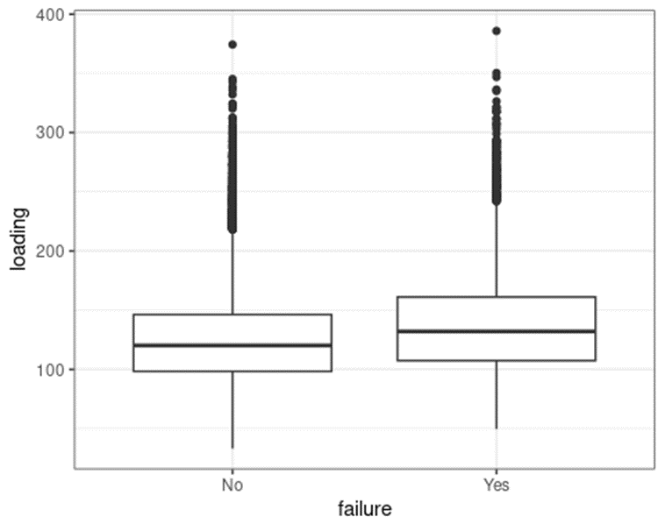
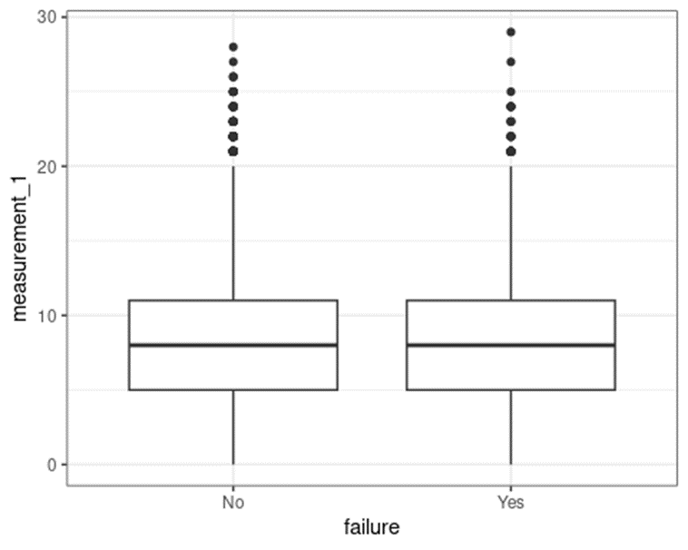
Visuals of other variables
For Measurements_1 through 17, there does not appear to be a difference in product failure or not based on the measurement length. Example of Measurement_1 below:
The mean loading time appears to be higher with product failure.

